Slide 1
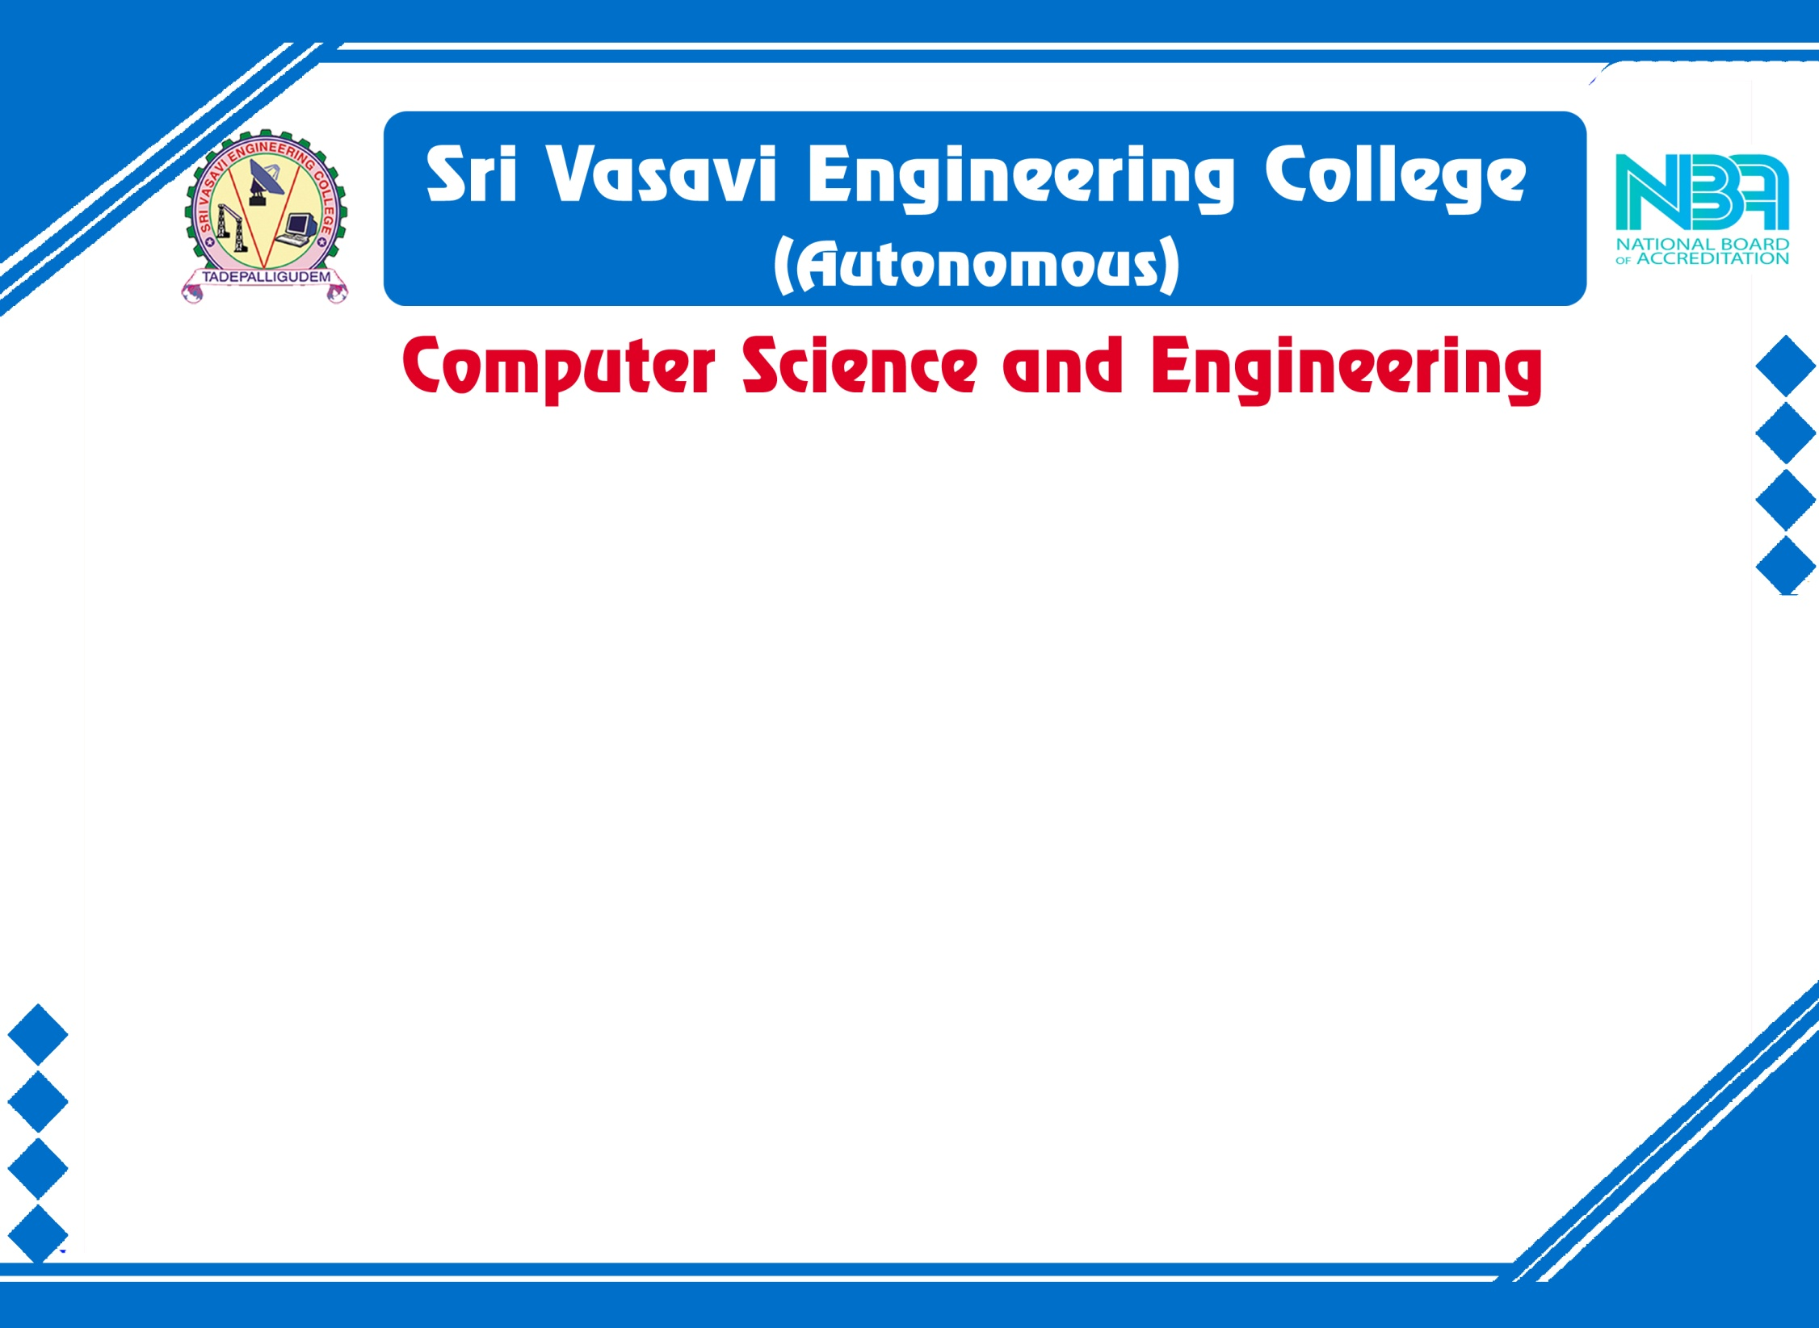
Mini Project External Review
Batch No: 1
Project Title: EPIC Destinations – Tour Recommendation
S. No. | Regd.No | Student Name
1 | 21A81A0501 | A. Haritha
2 | 21A81A0546 | P. Divya Priyanka
3 | 21A81A0552 | S. Harshitha
4 | 21A81A0534 | P. Adithya
5 | 21A81A0541 | P. Hema Vamsi
Project Guide:
Dr. D. Jaya Kumari M.Tech, Ph.D. Professor & HOD of CSE

Slide 2
CONTENTS
Title
Abstract
Introduction
Literature Survey
Problem Statements in Existing System
Proposed System
Objectives
Project Domain
Requirement Analysis
System Architecture and Design
Implementation
Result Analysis
Attainment of objective
Conclusion
Methodology
Future scope of Project

Slide 3
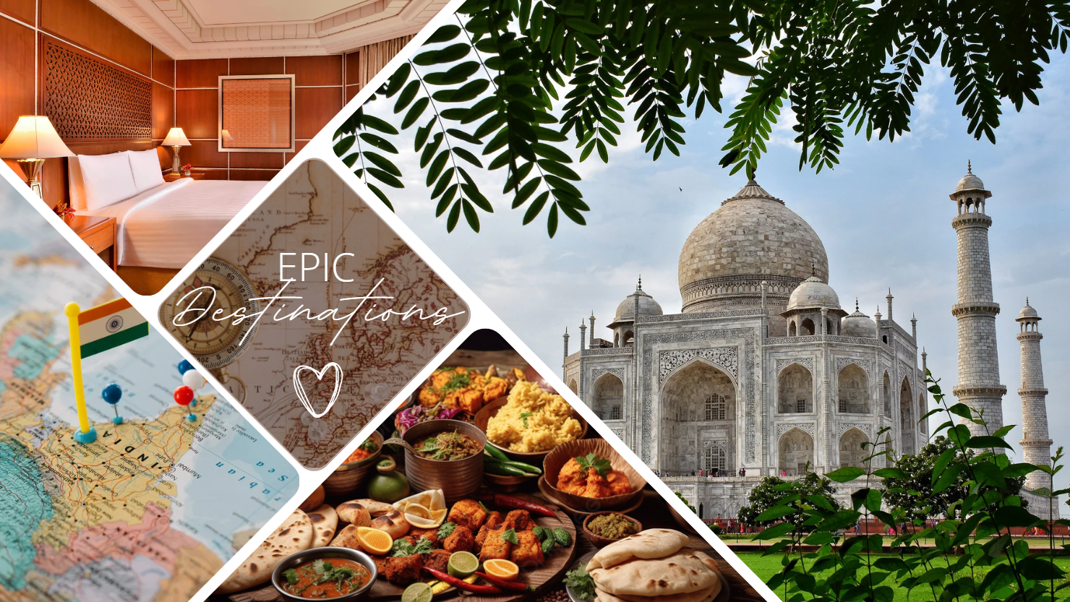
TITLE:
EPIC Destinations
Enhanced
Personalized
Itinerary
Curation

Slide 4
Abstract
Tourism is a successful industry globally, offering a welcome break from our daily routines. However, planning a tour can be a daunting and time-consuming task. Relying solely on recommendations from friends limits our options to their personal experiences, while travel agents may have biased suggestions aimed at selling packages. Navigating the vast expanse of the internet for research often leaves travelers frustrated and overwhelmed. To address these challenges, we propose EPIC Destinations, an intelligent tour recommendation system that utilizes collaborative filtering to provide personalized suggestions for travelers. Our website optimizes itineraries, recommends the best places to visit, and offers insights on hotels, local cuisine, ideal timings, and transportation options. By leveraging advanced algorithms and data analysis, EPIC Destinations considers factors such as user feedback, popular attractions, local events, and travel patterns to ensure accurate and unbiased recommendations that cater to individual preferences. Therefore, Through the power of collaborative, our website enhances the overall travel experience, empowering users to optimize their adventures and create unforgettable memories.

Slide 5
Introduction
Tourism has become a very important part of our life. By taking a nap from our daily work life we often want to prefer spending some time somewhere along a sea coast or on a hill station and be at complete peace. In response to the growing importance of taking breaks from our daily routines and seeking peaceful getaways, planning tours has become challenging and time-consuming. While recommendations from friends and travel agents are often limited or biased, searching the internet for solutions can be overwhelming. To address this, we've developed a user-friendly Tour Recommendation System using collaborative filtering. By considering factors like interests, locations, food preferences, and optimal visiting times, the system generates tailored suggestions and day plans. It calculates travel time and time spent at each location to help users efficiently plan their trips. The system also offers real-time recommendations based on the plans of fellow users. This solution aims to simplify and enhance the tour planning experience for users, offering tailored and unbiased recommendations. This application streamlines the tour planning process, making it efficient and enjoyable.

Slide 6
Literature Survey
S.No | Title of Article | Authors | Description
1. | A Machine Learning Approach to Building a Tourism Recommendation System using Sentiment Analysis | Abhishek Kulkarni, R. M. Samant, Prathamesh Barve, Aarushi Phade | Analysis of various machine learning and deep learning algorithms has been done and their behavior has been studied.
2. | Constrained interest-based tour recommendations in large scale cultural heritage virtual environments | Vasileios Komianos, Konstantinos Oikonomou | The aim is to deal with these issues by providing users with constrained interest-based tour recommendations.

Slide 7
Problem Statement in Existing System
Inefficient and Biased Travel Recommendations
Information Overload and Confusion
Lack of Personalization in Trip Planning
Proposed System
Our idea is to create a special website that helps people, to plan their trips in a way they wish. This system will learn about people's interests and travel habits from the places they like. Then, it will use this information to suggest cool places to visit, yummy foods to try, and the best times to go. Plus, it will keep getting better at giving suggestions as more people use it and share their thoughts. This way, everyone can have a super fun and personalized travel experience without feeling confused or spending too much time searching on the internet.

Slide 8
Objectives
The main objective of the project is to provide efficient personalized recommendations and unbiased suggestions for tour planning.
Personalized Planning: Create a system that understands users' interests and behaviors to offer personalized travel plans, considering their preferences.
Impartial Suggestions: Develop algorithms that provide fair and varied travel recommendations, reducing personal biases and financial motivations often present in traditional advice sources.
Real-Time Adaptability: Build a system that adjusts recommendations based on users' inputs, ensuring plans stay relevant and adaptable to changing situations, enhancing the overall travel experience.
User-Friendly Interface: Design an easy-to-use platform where users can input preferences, receive practical itineraries, and provide rating for ongoing enhancement.

Slide 9
Project Domain
Our project domain is Web-technologies
HTML, which stands for Hypertext Markup Language, is a fundamental language used for creating and structuring content on the web. It provides a standardized way to define the structure and elements of a web page, including text, images, links, headings, lists, and more. HTML uses a system of tags to mark up content, allowing browsers to interpret and display it appropriately. By using HTML, web developers can create cohesive and organized web pages that can be accessed and rendered across different devices and browsers. It forms the foundation of web development and is often combined with other technologies like CSS (Cascading Style Sheets) for styling and JavaScript for interactivity, enabling the creation of rich and dynamic web experiences.
Database Design
We used MySQL Database and PHP- XAMPP connection for the login section

Slide 10
Requirement Analysis
Functional Requirements | Non- Functional Requirements
User Registration and Login Recommendation Generation Detailed Tour Information Real-Time Adaption User Feedback Loop Database Management Privacy and Security | Performance Scalability Usability Privacy and Security Localization Compatibility Availability

Slide 11
Requirement Analysis (contd..)
Software Requirements | Hardware Requirements
Languages: HTML and CSS Operating System: Windows IDE: Microsoft Visual Studio DB: MySQL using XAMPP | CPU: Intel(R) Core(TM) i5- 1.30 GHz HDS: 20 GB or more RAM: 4 GB RAM

Slide 12
System Architecture
Initial Planning
Alternative Search & Comparison
Begin Travel Arrangements
Budget Planning
Scheduling & Ticketing
Personal Wish List
Itinerary
Execute

Slide 13

DESIGN
UML DIAGRAM
Home
USERS
Not Yet Registered?
Login
Register
Already Registered?
Check email and password
Invalid Password
Password Matched
Access the Internal Functionalities
Logout

Slide 14
IMPLEMENTATION
REQUIREMENTS GATHERING:
Dataset Preparation: We curated datasets, including "Marvels India" and "Seasonal Escapes," forming the basis for travel suggestions.
Image Collection: We sourced images from AI tools and the internet to enhance the visual aspect of travel recommendations.
Technology Selection: We meticulously selected tools and technologies to support the development of our project, ensuring a robust and user-friendly platform.
FRONT-END DEVELOPMENT:
Design and Structure: We meticulously planned the project's structure and visual appearance, ensuring an appealing and user-friendly interface.
Technology Implementation: We leveraged HTML, CSS, and JavaScript to create a dynamic and interactive front-end, enhancing the user experience.
Visual Enhancement: Background images were expertly edited using Canva, contributing to the project's aesthetics and overall appeal.

Slide 15
IMPLEMENTATION
DATABASE DESIGN:
We used MySQL Database and PHP- XAMPP connection for the login section; for that we downloaded XAMPP and MySQL from browser.
Open XAMPP Control Panel; start APACHE and MySQL. Then click on admin then created database epic_destinations_db and users table with email and password columns.
Then we downloaded MySQL Download in VS Code. And in which we created EPIC_db; which is connected to localhost/phpmyadmin/
BACKEND DEVELOPMENT:
Rating System Implementation: We introduced a rating section, allowing users to provide feedback and ratings. To enhance this system, we integrated collaborative filtering techniques to offer personalized and relevant recommendations based on user interactions and preferences.
User-Centric Recommendations: The collaborative filtering approach ensures that the project's recommendations are finely tailored to individual user preferences, promoting a highly personalized and satisfying travel planning experience.

Slide 16
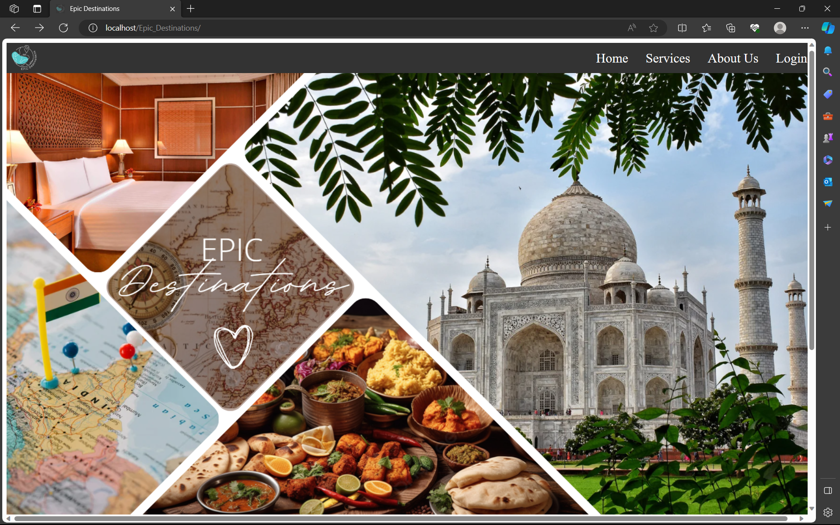
RESULT ANALYSIS
This is the screenshot of the initial user interface of EPIC Destinations.

Slide 17
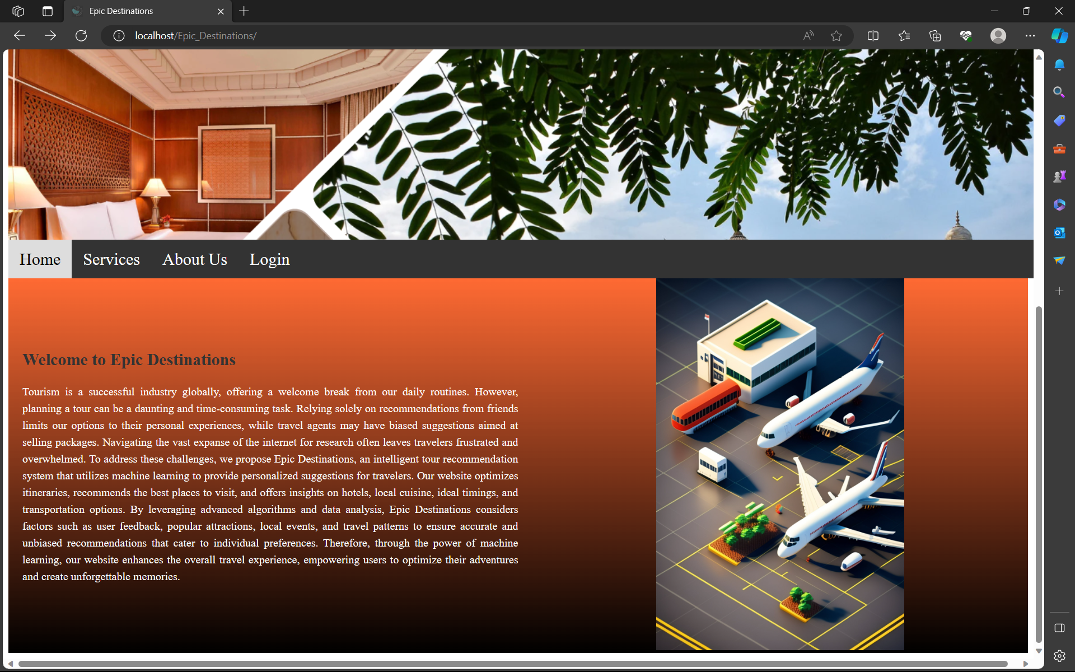
RESULT ANALYSIS
This is the screenshot of the Home Section of EPIC Destinations.
Similarly, Services and About Us sections appear.

Slide 18
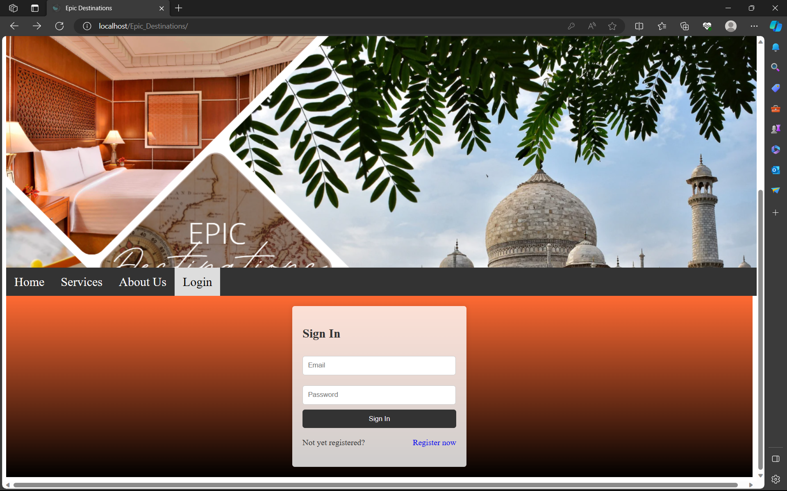
RESULT ANALYSIS
The below screenshot of the Login section of EPIC Destinations.

Slide 19
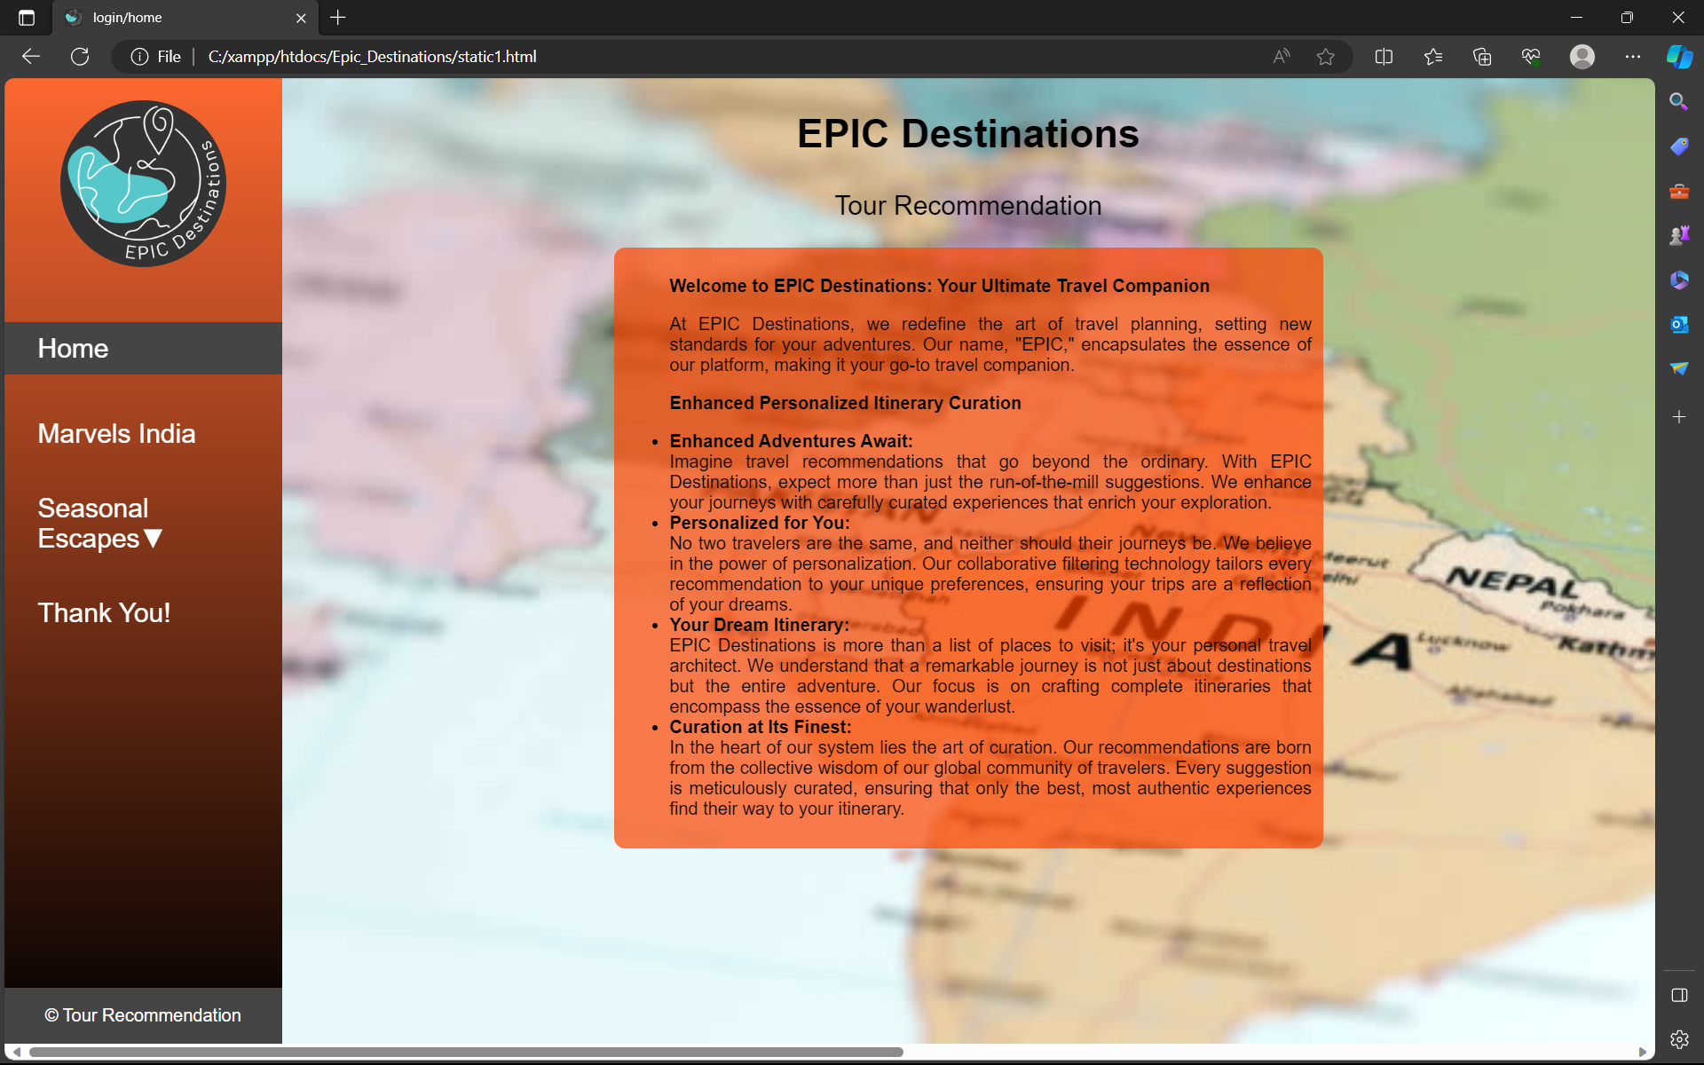
RESULT ANALYSIS
This is the screenshot of the page is after logging into EPIC Destinations.

Slide 20
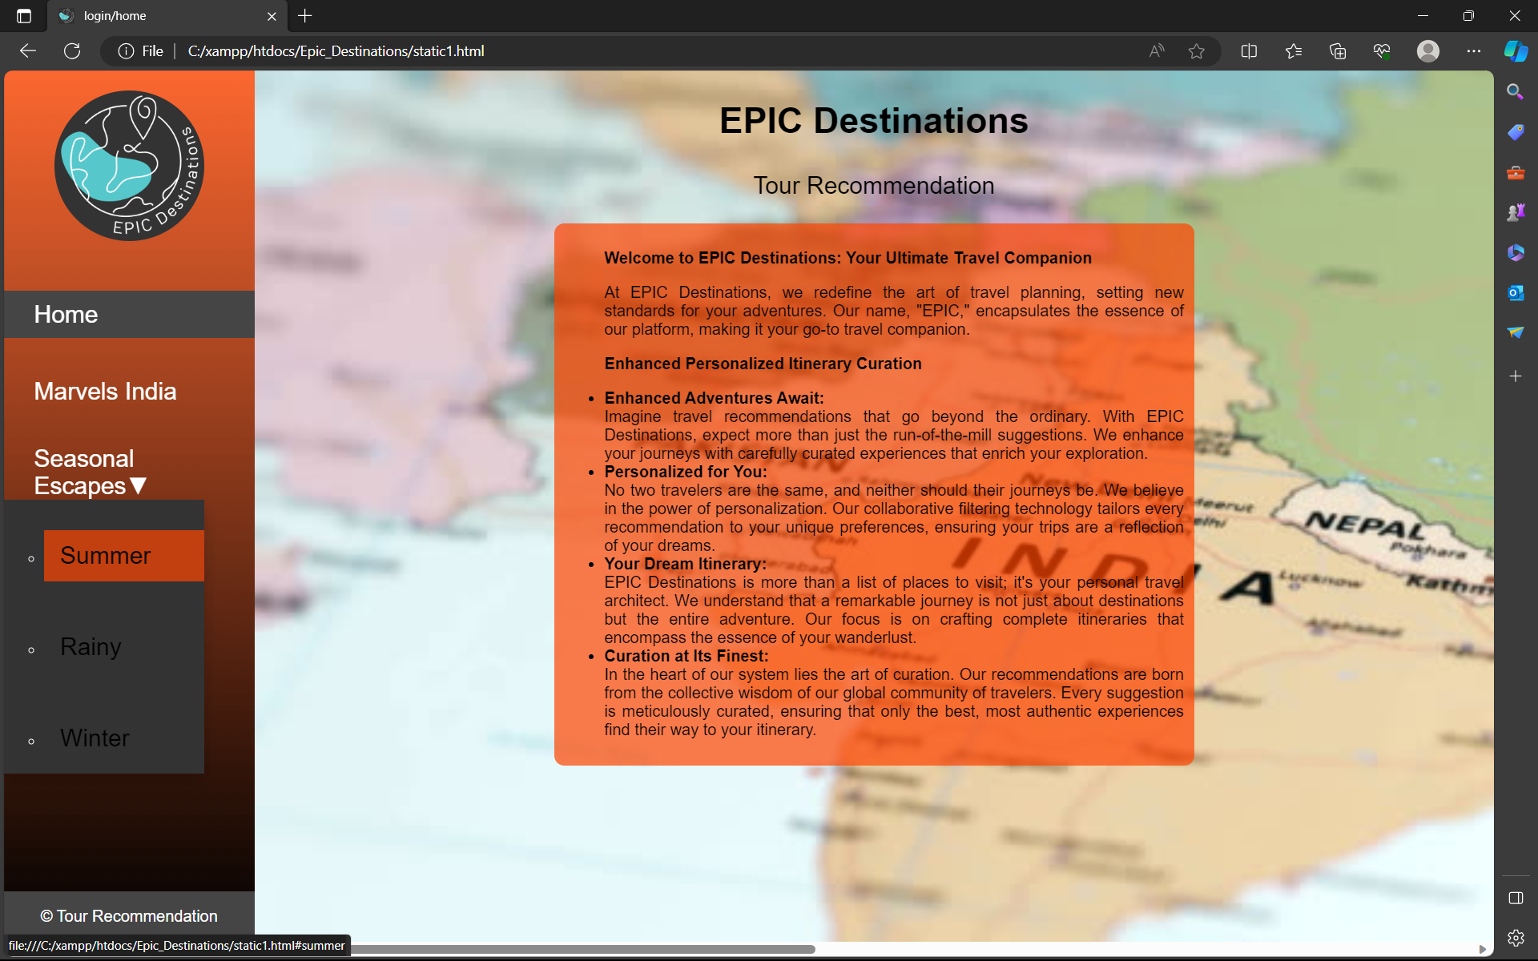
RESULT ANALYSIS
This is the screenshot of the page when the mouse hovers on the option Seasonal Escapes

Slide 21
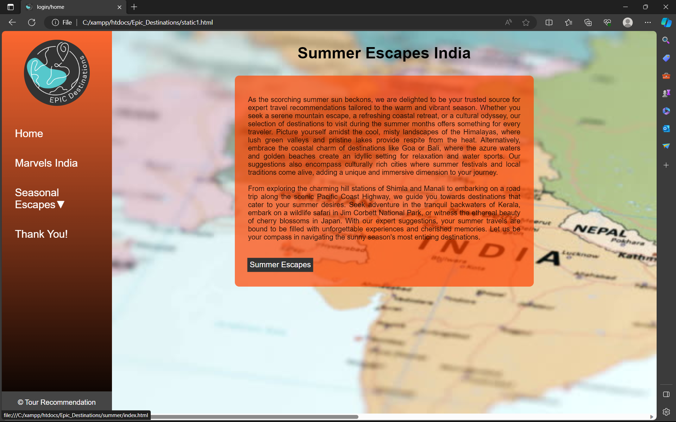
RESULT ANALYSIS
The below screenshot of the Summer section of Seasonal Escapes.

Slide 22
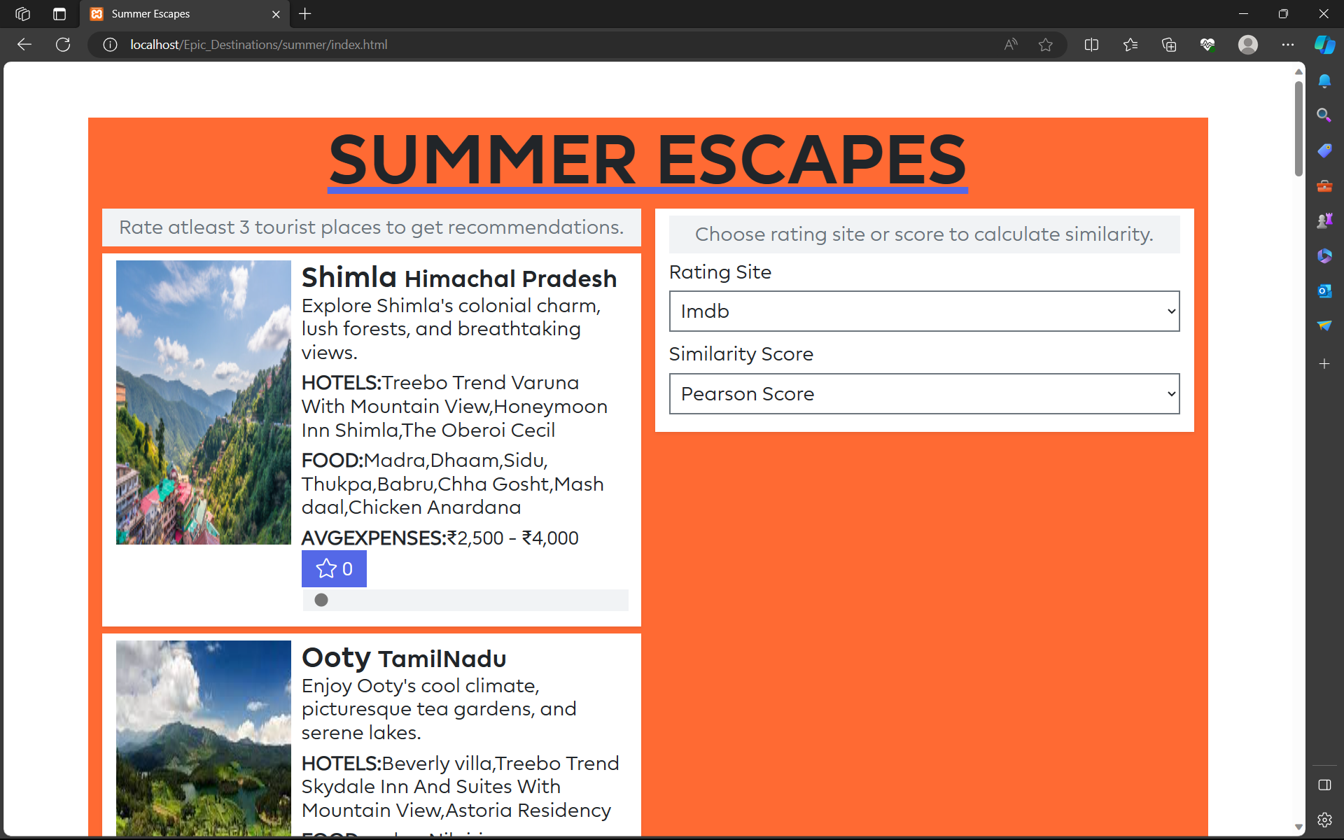
RESULT ANALYSIS
This screenshot of the page is when the clicked on the option Summer Escapes, in Summer Section.
Similarly, Marvels India, Rainy Escapes and Winter Escapes pages appear.

Slide 23
ATTAINMENT OF OBJECTIVE
The project successfully fulfills its objectives by offering personalized travel suggestions based on seasons, featuring the “Wonders in India," and providing insights into local cuisine and nearby restaurants. Users can access information on average daily expenses and the ideal time to visit. Real-time adaptability is facilitated through user ratings, while the user-friendly interface ensures a uninterrupted travel planning experience. This approach ensures that travel recommendations are both suited for individual preferences and free from bias, enhancing the overall travel experience.

Slide 24
CONCLUSION
In conclusion, our project has successfully achieved its primary objectives, offering users a comprehensive and personalized travel planning experience. By providing customized recommendations based on seasons, showcasing India’s “Wonders," and offering insights into local cuisine and dining options, we ensure that travelers can make informed decisions. The system's real-time adaptability through user ratings, combined with the user-friendly interface, further enhances the travel planning process. This approach not only supports personalization and impartiality in travel recommendations but also ensures that users can enjoy a more enriching and user-centric travel experience. We look forward to continuing to refine and expand our platform to further serve the needs of our users in their travel adventures.

Slide 25
Methodology
The development methodology for the proposed Personalized Travel Recommendation System follows an Agile approach with a data-driven iteration cycle. It begins with gathering requirements from stakeholders and users, defining both functional and non-functional aspects. User profiling and data collection mechanisms are established to create detailed user profiles from online activities and interactions. The core system components, including collaborative filtering algorithms and real-time adaptation features, are developed. User testing and feedback collection inform iterative refinement cycles, leading to enhanced recommendation accuracy and user interface improvements. Privacy measures and database setup ensure data security. The system is integrated with external travel services, then thoroughly tested and deployed. Continuous learning is emphasized through user feedback, enabling regular updates to maintain relevance and improve recommendations. This methodology ensures a user-centric, adaptable, and secure travel recommendation system.

Slide 26
FUTURE SCOPE OF THE PROJECT
The future scope of our project is to further enhance and expand the platform, with a focus on providing a comprehensive travel experience for users. This will include the following features:
Location Information: We will incorporate detailed location information for each travel destination. This will encompass geographical and cultural insights, historical context, and local attractions, ensuring users have a holistic understanding of the places they plan to visit.
Emergency Contact Information: To prioritize traveler safety, we plan to integrate emergency contact numbers and relevant safety information for each destination. This feature will provide users with essential resources in case of unforeseen emergencies during their travels.
Activities and Things to Do: We will expand our offerings to include a broader range of activities and things to do at each destination. Users will have access to a variety of recommendations, from adventure sports and cultural events to historical tours and leisurely strolls, enhancing their travel experience.
Suggestions According to Categories: Our future development will introduce a refined category-based recommendation system. This will enable users to filter and explore travel options based on specific interests, such as adventure, relaxation, cultural exploration, or family-friendly activities.
Restaurant Recommendations: We will provide users with a curated list of restaurant options at each destination, complete with detailed information about the cuisine, ambiance, and pricing. Users can easily find and choose dining establishments that suit their preferences.

Slide 27
Thank you!!!

